Slide 1
PGDM 2024 – 2026
(PALAS Batch)

Slide 2
Project Overview – Internship at ASAPP Info Global (IMPACCT Division)
Company : ASAPP Info Global Services Pvt. Ltd. – IMPACCT Division (Infrastructure Intelligence Platform)
Area : Infrastructure Analytics | Data Estimation | AI-Driven Insights
Project: Implementation of Data-Driven Intelligence for Infrastructure Projects
OBJECTIVES
Enhance IMPACCT’s position as the “Bloomberg of Construction”
Enable data-driven decision-making through accurate steel & cement demand forecasting
Reduce latency in data collection and processing across the project lifecycle
Build a premium, AI-integrated platform focusing on high-value clients (e.g., Tata Steel, Autodesk)
Outsource and optimize scraping processes to ensure clean, legal, and efficient data pipelines
Support smarter, safer, and more sustainable infrastructure development

Slide 3






PROJECT BRIEF AND METHODOLOGY
Market & Platform Research
Studied data ecosystems, regulations, and key project platforms.
Automated Data Acquisition
Implemented scalable methods to collect and process infrastructure project data.
Data Structuring & Categorization
Organized raw data into structured formats aligned with business use cases.
Modeling & Analytics Framework
Developed estimation logic and performance indicators for material demand forecasting.
System Integration & AI Readiness
Enabled future integration of AI models and dashboard systems.
Platform & Report Support
Supported the platform’s internal dashboard development, including reports for client visibility and use-case demonstration.

Slide 4
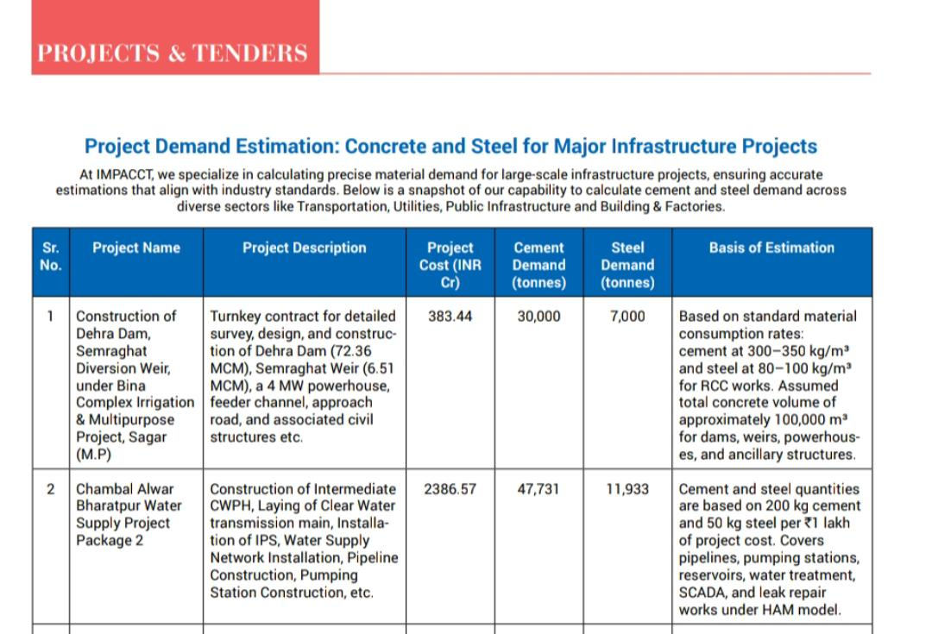
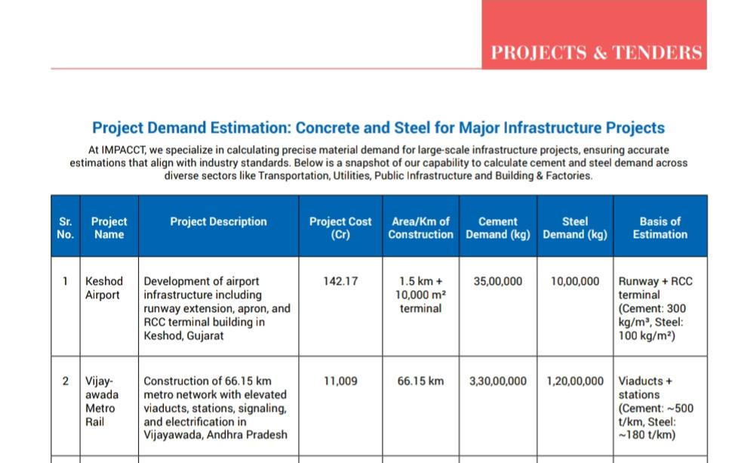
Results – Community Engagement
Strengthened IMPACCT's position as a data authority by developing KPI-driven dashboards and publishing strategic reports
Accelerated client engagement by creating structured, data-backed insights that improved platform pitch-readiness
Built a clean, reliable database increased internal efficiency and external trust
Boosted platform’s market visibility via reports, catalogues, and published work
My estimations in the company’s magazine

Slide 5






Results & Outcomes
Objects Analyzed
3000+
KPIs Designed
100+
AI Integration
with DB
Material Type forecasted
Steel & Cement
Enterprise Clients Approached
Product Catalogue Built

Slide 6
Impact, Insights & Takeaways
Gained hands-on experience in real estate analytics, data engineering, and AI readiness
Developed an understanding of industry-specific data ecosystems
Improved ability to design end-to-end data workflows, from extraction to decision dashboards
🔍 Learnings
⚠️ Challenges
Faced captcha and legal roadblocks during automated data scraping
Mitigated risk by outsourcing scraping to a compliant, specialized third-party vendor
Scope and responsibilities were more technical than managerial, highlighting a misalignment with personal strengths and career interests in strategic execution and project management

Slide 7
Impact, Insights & Takeaways
What Could Have Been Done Better
While the project was successful on the technical front, the opportunity to take on strategic ownership and decision-making remained limited
Future roles could benefit from a more balanced focus on technical execution and managerial exposure to maximize end-to-end impact
Value Added to IMPACCT
Delivered a clean, AI-compatible database, structured product catalogues, and 100+ KPI models
Enhanced the platform’s scalability, pitch-readiness, and client acquisition potential
Reflections
Discovered a personal strength and passion for strategic planning, stakeholder alignment, and product thinking
Realized a preference for cross-functional coordination over purely technical development

